Slide 1

Metro RDA Internship
Firas Hilman Metro RDA [Intern]

Slide 2



Who Am I?
I am Firas Hilman, a Singapore Polytechnic Intern studying electrical and mechanical engineering as well as business. Being part of the semiconductor has been a keen interest, and it was an honor being an intern at a leading player in the industry, Micron.

Slide 3

What I am to achieve?
Gain Industry Knowledge of semiconductors and memory
1
2
Refine Technical and Software Skills
3
Build a deep professional network within the industry

Slide 4


Business Model
Company
As a global leader, it specializes in designing, developing, and manufacturing advanced memory and storage products.
Product
Dynamic random-access memory, flash memory, and USB flash drives. Essential for creating rapid advancements in various fields such as artificial intelligence.
Benefits for AI
Provide the necessary speed and capacity for these demanding applications, driving advancements in AI

Slide 5




What is Metrology?
Quality Control
Yield Improvement
Advancement of Technology
Reliability Assurance
Metrology provides the data needed to maintain high-quality standards. It ensures that each component is built correctly and will function as intended.
By detecting defects and non-conformities, metrology helps in improving the yield of usable chips from each wafer, which is essential for cost efficiency.
As semiconductor technology advances, metrology evolves to measure ever-smaller features, facilitating the development of next-generation devices.
The reliability of semiconductor devices is paramount, especially in critical applications. Metrology ensures that devices will not fail prematurely.

Slide 6
My tasks
Adc Daily Validation
Liaising with Team
Conduct daily ADC validation to ensure ADC is functioning as expected. Report issues such as overkill and underkill
Engaging with team members for feedback and improvements to tailor solution to their needs.
Flip Chip analysis
ATI Data Processing
First project to create a solution for flip chip analysis
Second project to create a solution to process a text file for data analysis

Slide 7
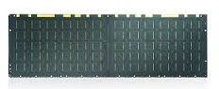
Inspection Levels
150000 -180000
Date
30000 – 36000
Device
5000 – 6000++
Machine
1000 – 1200 ++
Lot
100 - 120
Strip
1-5
Defect
1
Die

Slide 8
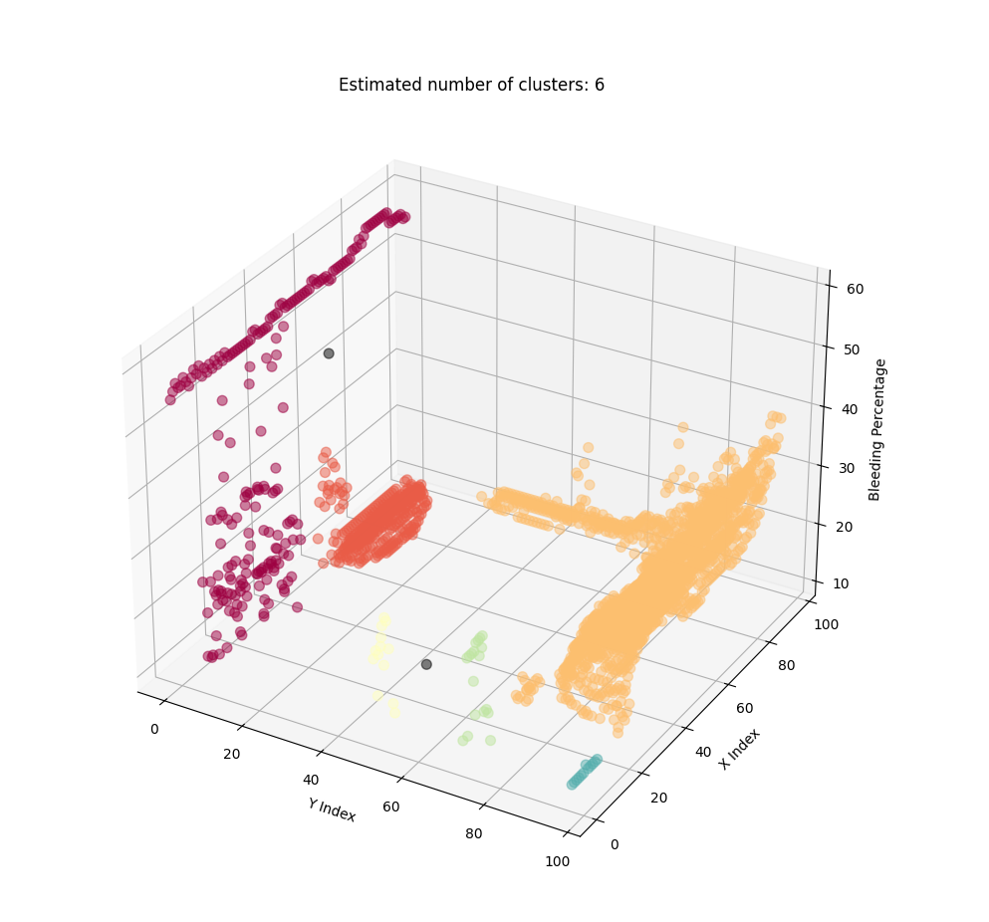
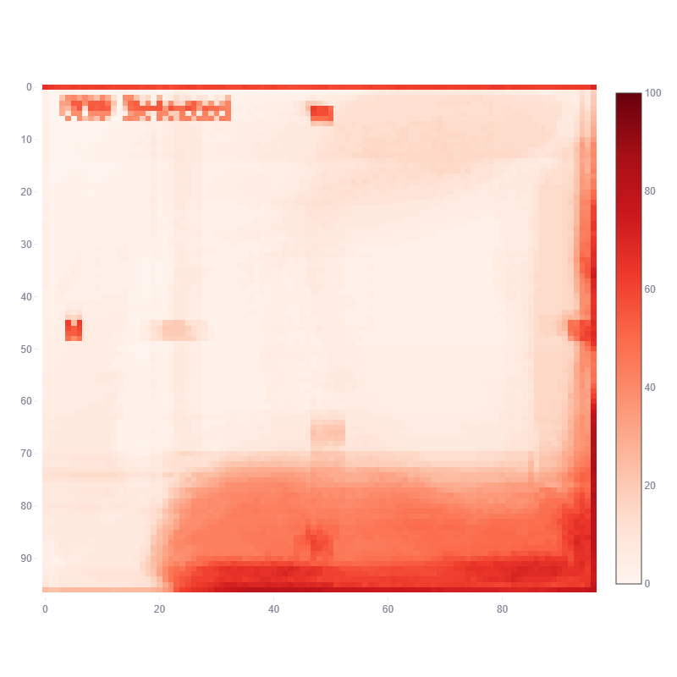
Flip Chip Analysis
How to create a flip chip analysis method for underfill dispense on die level?

Slide 9
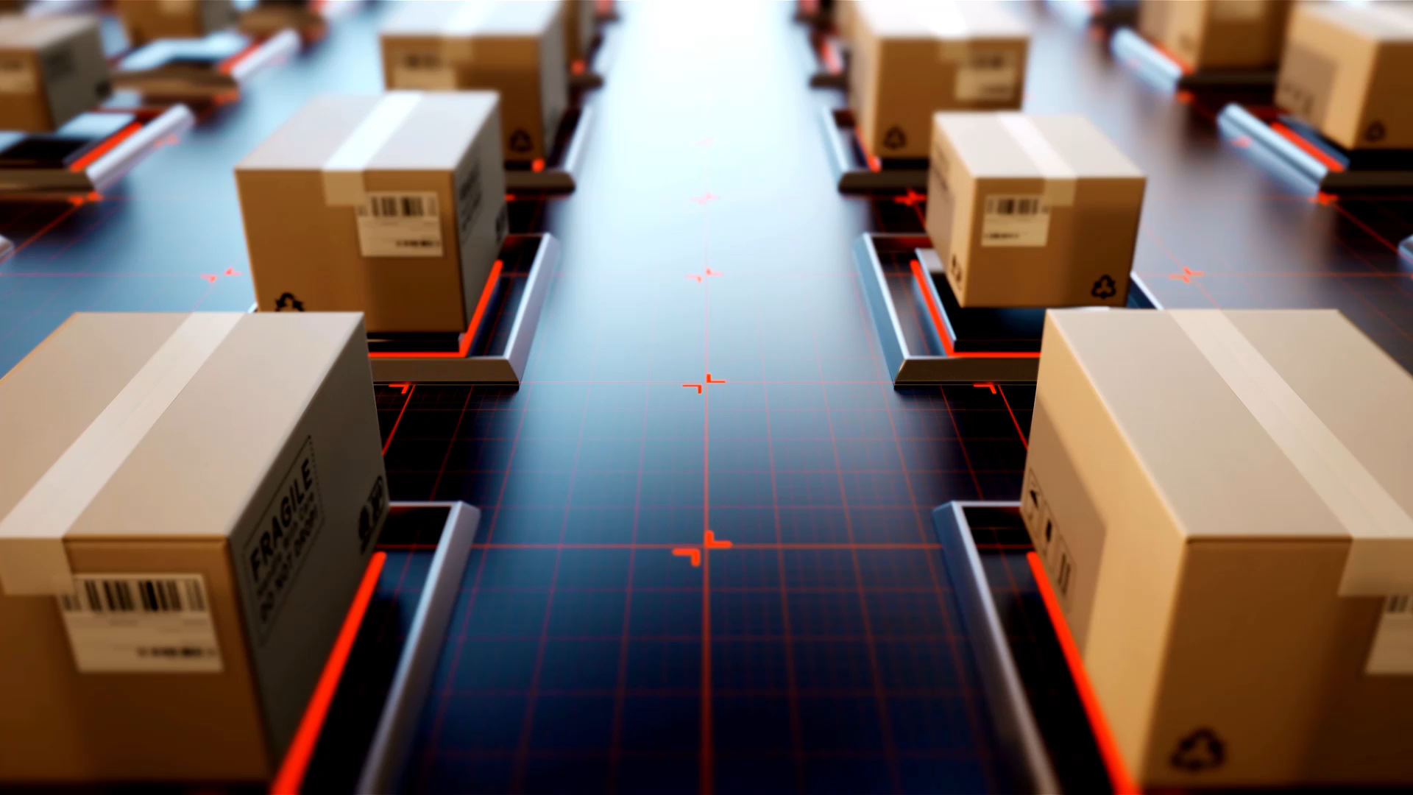
What is flip chip?
Flip Chip, also known as controlled-collapse chip connection, is an advanced semiconductor packaging technique used in the manufacturing of memory components.
Flip Chip allows direct attachment of a chip or IC to a substrate or circuitry. Instead of the traditional wire bonding method, flip chips are connected using Copper pillars.
Flip Chips offers many advantages such as miniaturization, improved performance due to its high interconnectivity and shorter signal paths.
Flip Chip requires an underfill dispense between the chip and substrate to prevent air pockets.

Slide 10
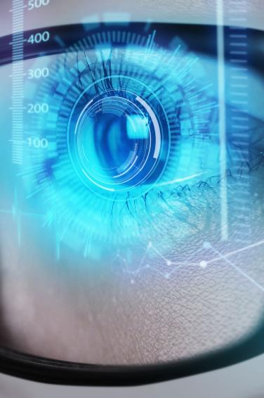
Underfill Problem
Limited Analysis
Inefficient
Inaccuracy
Analysis of Underfill is limited to lot level and does not analyze the actual underfill dispense on the die.
Engineers are required to look through hundreds of images to find a pattern among defects, which can take multiple hours for several lots.
Lack of proper representation of findings and are limited by the biasness of the engineer. No proper calculation or readings.
Human dependent
Engineers manually and visually inspect dies in a lot.

Slide 11
Current Inspection
150000 -180000
Date
30000 – 36000
Device
5000 – 6000++
Machine
1000 – 1200 ++
Lot
100 - 120
Strip
1-5
Defect
1
Die

Slide 12





Project Scope
Underfill Analysis
Anomalies classification
Data Visualization
Automated Updates
Create a program to convert underfill images to numeric data
Using numeric data to analyze patterns and highlight outliers
Present findings and data in appropriate graphs and visualizations
Update stakeholders and engineers of findings using automated emailing service

Slide 13
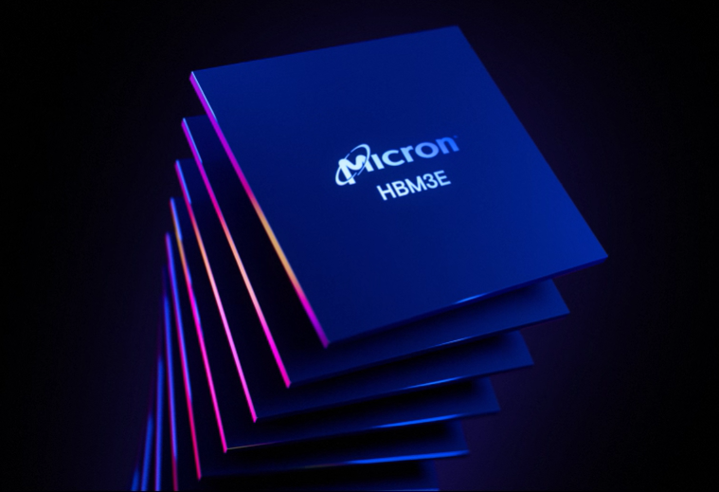




Solution

Slide 14
ADC UF hotspot Detection
Data Analysis
Graphics & Visuals
Python is a versatile programming language, has wide range of libraries for data analytics. Python handle backend data processing.
Plotly is a data visualization library which creates interactive high quality graphics including 3D plots. Plotly will be used to visualize complex data.
UI/UX Dashboard
Emailing Service
Streamlit creates web user interface, allowing for custom web applications and user interaction through dashboard. Streamlit will handle the frontend user inputs and outputs.
Simple Mail Transfer Protocol, SMTP allows for sending emails between servers. Together with HTML, SMTP will be used to send emails to engineers

Slide 15

Python – Data Processing
The Backbone
Image Processing
Complex Calculations
Machine Learning
Python augments the image into black-white, converts images into a NumPy array for calculations of values, [0-255].
Python takes the array and runs a formula/function to return area, count, and percentage.
Calculated variables is used for predictive machine learning, 3D Clustering, and classification.

Slide 16
StreamLit – UI/UX Dashboard
The Canvas
Web Deployment
User Interaction
caching
Streamlit allows for both local and network deployment, providing access to anyone under the same network.
Streamlit includes widgets and in-built functions providing a wholesome user experience. Upgradable with LLMs and AI
Streamlit can store data in its memory to be used for further iterations, allowing the app to stay performant when loading, or running expensive computatios.

Slide 17
Plotly – Graphics & Visuals
The MSG
Interactive Graphs
Customizable
Visual appeal
Users can zoom in and out, hover over data points to see their values, focusing analysis to certain areas.
Colors and graphs can easily be switched to suit data and highlight important information.
Graphs are visually attractive and easy on the eye.

Slide 18
SMTP – Emailing Service
The Finishing Touch
Server Compatible
HTML Content
Bulk Mailing
SMTP can send emails through a dedicated server ensuring reliability in email delivery.
Email content can be customized in a template to include important information for engineers
Emails can be sent to multiple recipients at once, ensuring prompt updates of defects analysis.

Slide 19
Start
Display 2D Heatmap
Cluster Data Points
F
L
O
W
C
H
A
R
T
Open image folder
Calculate Area of Bleeding
Display 3D Cluster
Crop Images
Convert Data to CSV
Create Email Report
Split Images
Create Data Table
If email
If download
Email Report
Download CSV
Calculate Darkness
Combine Darkness Score
END

Slide 20
If pixel darker
True
Get Pixel Count
New Data frame
Separate X,Y, %
START
True
False
Darker pixel + 1
If 15<%>100
Cluster Data Points
Open image folder (start)
For sub- images:
Lighter pixel + 1
Calculate Darkness %
Plot data point by clusters (end)
Get Median Color
Display data as heatmap
Get file quantity
For images:
Split by rows & columns
If end
If % > area %
Save % array into csv
END
True
If jpg or png
Convert to NumPy
Darkness score +1
Calculate die bleed %
If email
If download
Crop Image
Convert to GRAY
Convert to %
Convert to data frame
Email Report
Download CSV
FLOWCHART
END

